Slide 1
Welcome to
Organisations: People, Culture; Size & Structure

Slide 2
Learning Objective
By the end of the lesson you will be able to:
Describe factors that affect business activity in an organization
Understand difference between culture and corporate culture
Discuss the determination of culture and its importance to an organization
Describe the dimension of organizational culture

Slide 3
Activity – 5 minutes
Using the Post It Note; describe the qualities you want for a friend.

Slide 4
Business Organisations : Internal Environment
Organisations structure
Functions
Organisational objectives
Manage the different influences
Adapt to new external influences
Manager – people, technology, structures and environments

Slide 5
The Concept of…’Organisation’
“Two or more people who work together in a structured way to achieve a specific goal or set of goals”.
                Stoner and Freeman (1992:4)
Can be in:
Private sector
Public sector
Voluntary (or third) sector

Slide 6
What are Organisations?
“Organizations are essentially collections of parts with endless points of discontinuity. Good designs build organizational capabilities, for instance to manage innovation, which equip organizations to compete successfully. Capabilities are the product of a combination of knowledge, routines and behaviour that are enabled by well designed work processes, structures and lateral processes, management practices and systems and rewards and people practices.”
(Cheung-Judge & Holbeche, 2011, p.212)

Slide 7
Hofstede’s cultural model
“The way in which members of an organisation relate to each other, their work and the outside world in comparison to other organisations”
Prof Geert Hofstede

Slide 8
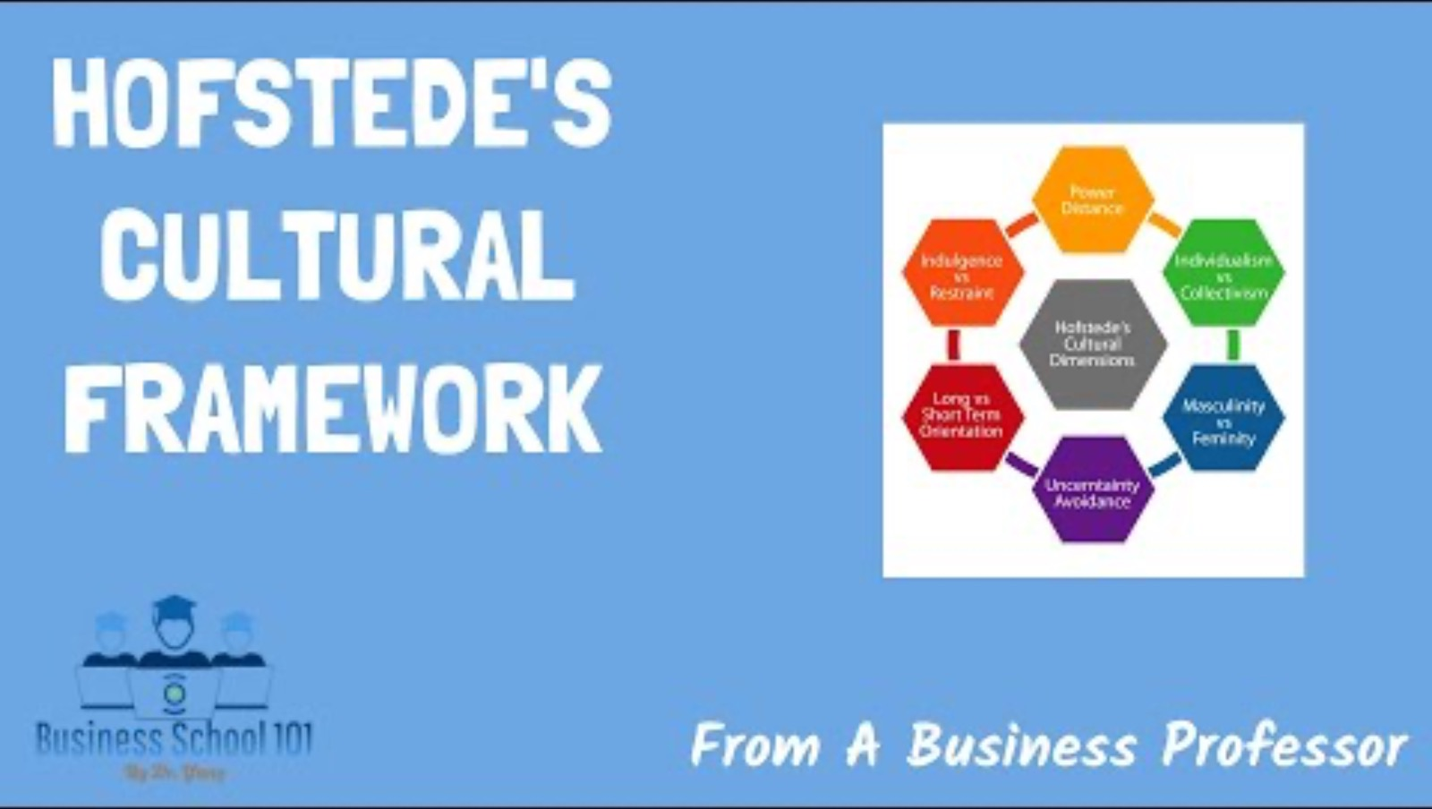

Slide 9
Hofstede’s Basic of dimensions of culture
Individualism—Collectivism: The degree to which the society is built around individual rights and duties versus the group being the basic unit of society to which individuals should subordinate themselves
Power Distance: The social and psychological status and authority distance between the highest and lowest powered people in the society
Masculinity—Femininity Distance: The degree to which gender roles are differentiated and linked to work versus home and family
Tolerance for Ambiguity and Uncertainty: The degree to which members of the society feel comfortable in uncertain and ambiguous circumstances; the need for clear structures, processes, and rules
Short-Run vs. Long-Run Time Orientation: The degree to which members of society plan for and fantasize about the distant future versus being concerned only about the near future
Schein and Schein, 2017:

Slide 10
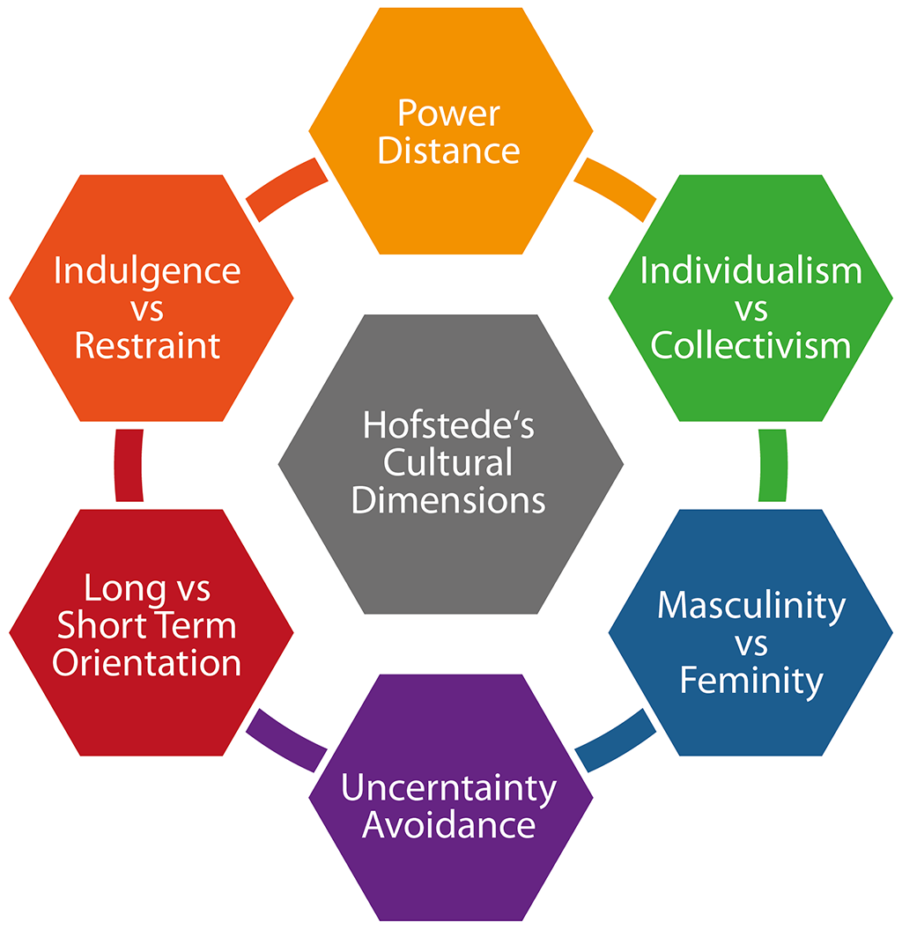
6th dimension added in 2010
Hofstede (2010)
See more Geert Hofstede and Gert Jan Hofstede on culture
Notes:
2010, added a 6th dimension ( Brevis and Vrba 2014)

Slide 11


Slide 12
The Problems with ‘Strong’ Cultures
Makes merging with an organisation more difficult
Attracts & retains similar kinds of employees thereby limiting the diversity of thought
Can be ‘too much of a good thing’ if it creates extreme behaviours among employees
May impede success if it encourages conformist attitudes
Thus possibility of ‘Groupthink’? (Janis, 1972)
Slow to develop & then difficult to change for reasons above
Strong does not necessarily mean ‘good’

Slide 13
Application: Zappos
Enter Zappos website (www.zappos.com). Scroll downwards and click on “About”, then scroll down and click, “Learn More About Zappos ONE Purpose,”
Questions:
What are the main elements of Zappos culture?
How does the Zappos company culture define their value?
How easy would it be to institute Zappos culture in other companies?

Slide 14
Culture Task
Think of an organisation you work in or have worked for
Tell me the pro’s and con’s for this individual company.
Think of an organisation you would like to work for:
1. Tell me the pro’s and con’s for this individual company.

Slide 15

Organisation Structure
Board of directors
Professionalism of management
Influences business decision
An efficient working of an organisation requires that the structure should be conducive for quick decision making

Slide 16
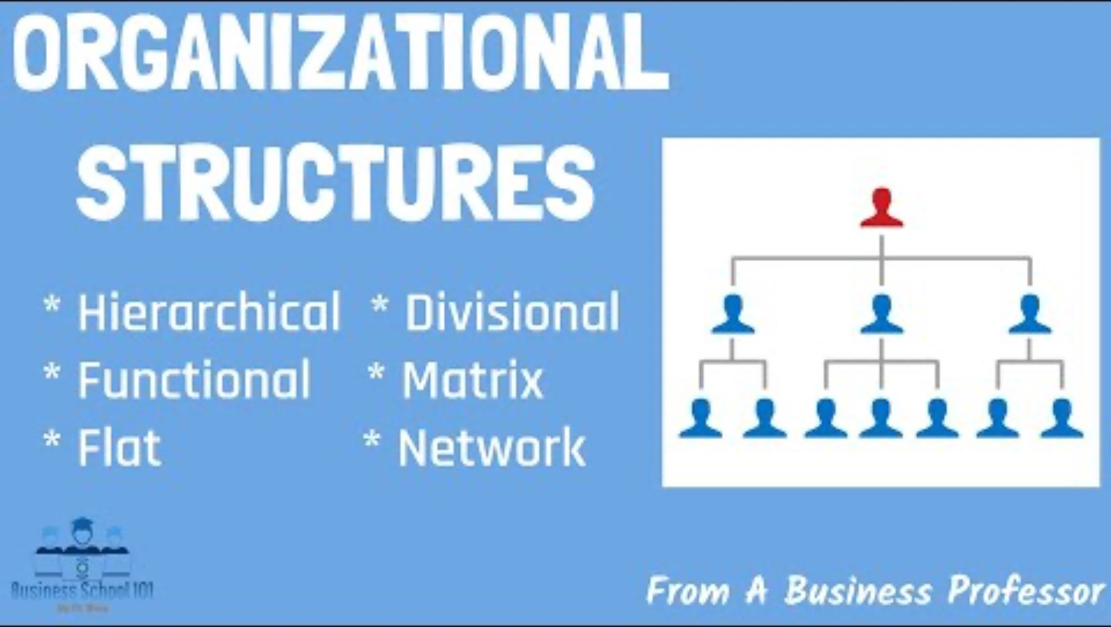

Slide 17
So…What does this structure enable?
Achieve efficiency in the utilisation of resources
Monitor organisational performance
Accountability of indicuals
Coordinate different parts of the organisation
Efficient and effective communication
Job satisfaction –progression opportunities
Adapt to change (internal or external developments)

Slide 18
References
Adams, A (2014). Law for Business Students (8th ed.). Harlow:Pearson
BALOGUN, J., and HOPE HAILEY V., (2008) Exploring Strategic Change 3rd Ed Essex: Pearson Education Ltd.
Boddy, D. (2017). Management: An Introduction (7th ed.). Harlow: Pearson.
BUCHANAN, D.A. and HUCZYNSKI, A.A. (2010) Organizational Behaviour 7th ed. Essex: Pearson Education Ltd.
CARNALL, C. (2007) Managing Change in Organizations 5th Ed. Essex: Pearson Education Ltd
Dignam, A & Lowry, J. (2012). Company Law (8th ed.) Oxford: Oxford University Press
JOHNSON, G., WHITTINGTON, R., and SCHOLES, K., (2011) Exploring Strategy 9th Ed Essex: Pearson Education Ltd.
Lemieux, Victoria (1998) ‘Applying Mintzberg's Theories on Organizational Configuration to Archival Appraisal’. Archivaria 46 (Fall), 32-85
Mullins, L. J. (2016). Management & Organisational Behaviour. (11th, Ed.) Harlow: Pearson.
NATIONAL AUDIT OFFICE, 27 October 1999. The Passport delays of Summer 1999.
Needle, D. (2015). Business in Context. Andover: Cengage.
Online Talent Manager (2018) The Quinn Model: A model of personality in the Competing Values Framework. [online] available from http://www.onlinetalentmanager.com/products/quinnmodel [25 September 2018]
PATON, R.A., and MCCALMAN, J., (2000) Change Management: An Guide to Effective Implementation 2nd Ed London: Sage Publications Ltd.
Slocombe, J (2009) Organisational Structure. [online] available from < https://www.youtube.com/watch?v=R-m8grawp1k > [25 September 2018]
Smart, P & Inazawa, K. (2011) Human Resource Management in the Public Sector. Hyogo: Kwansei Gaukuin University Press

Slide 19
Pawel.Jacek.Sawicki@gmail.com
Friday: 9-11

